Slide 1

What Is Big Data?

Slide 2
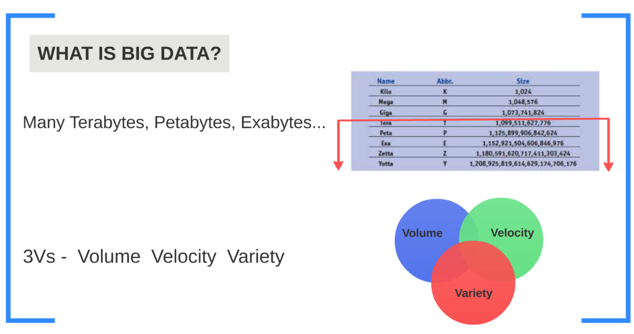

Slide 3
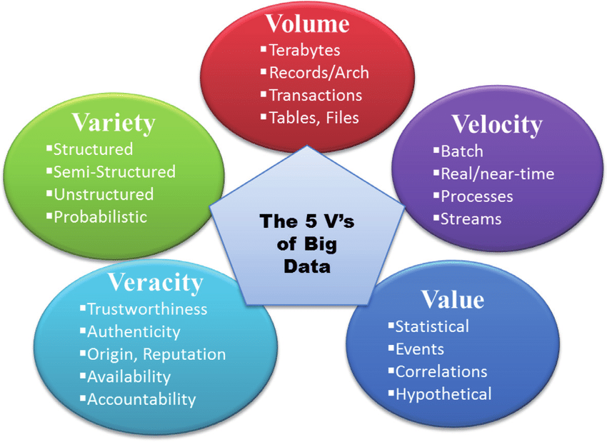

Slide 4
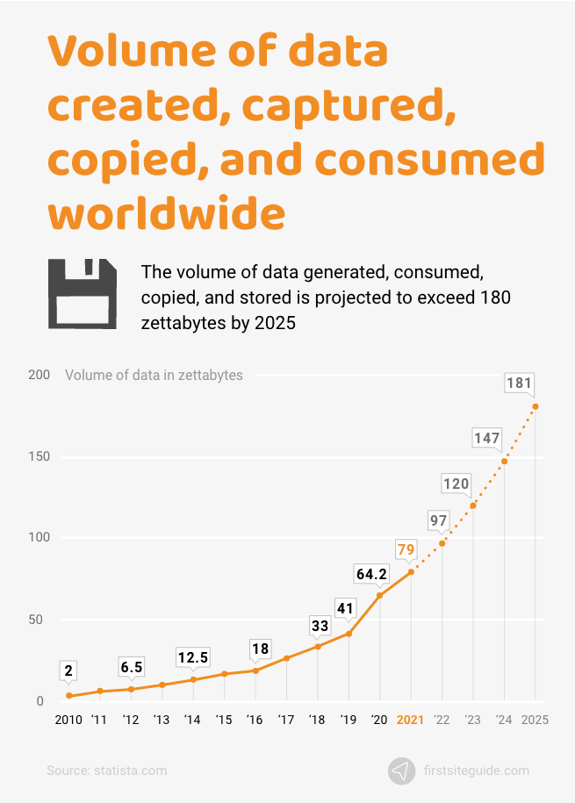
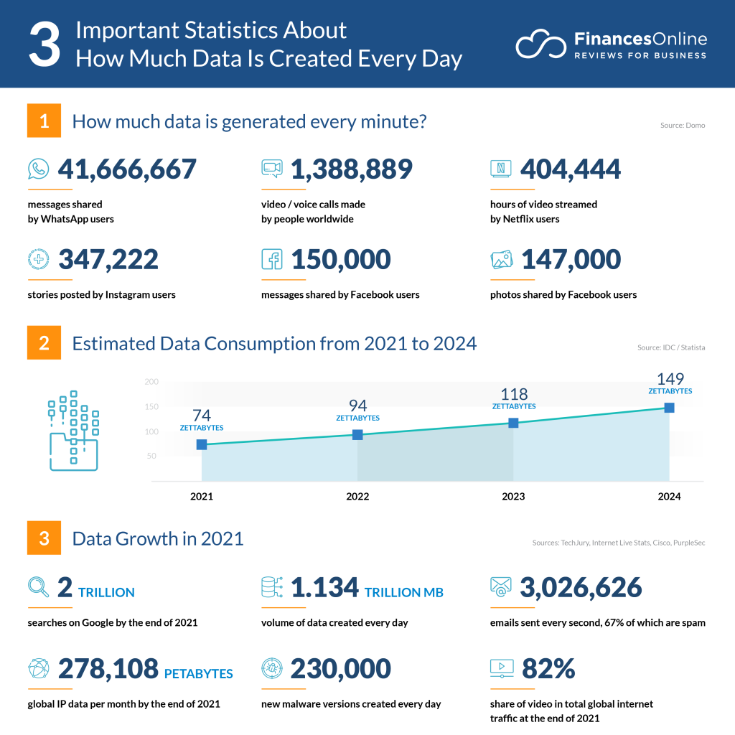

Slide 5
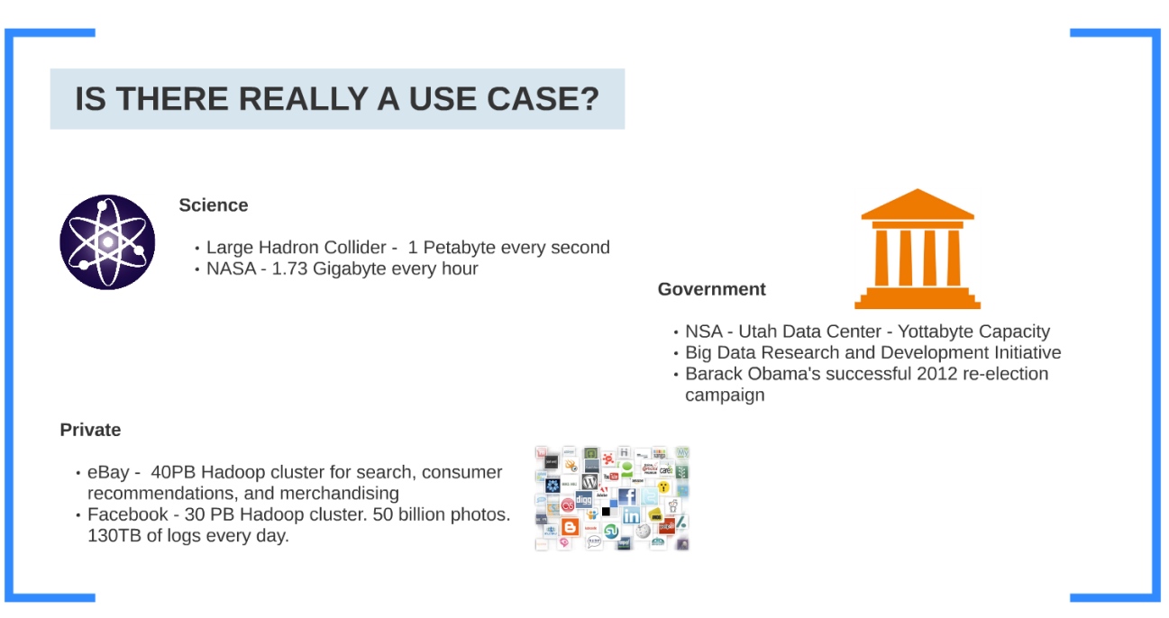

Slide 6
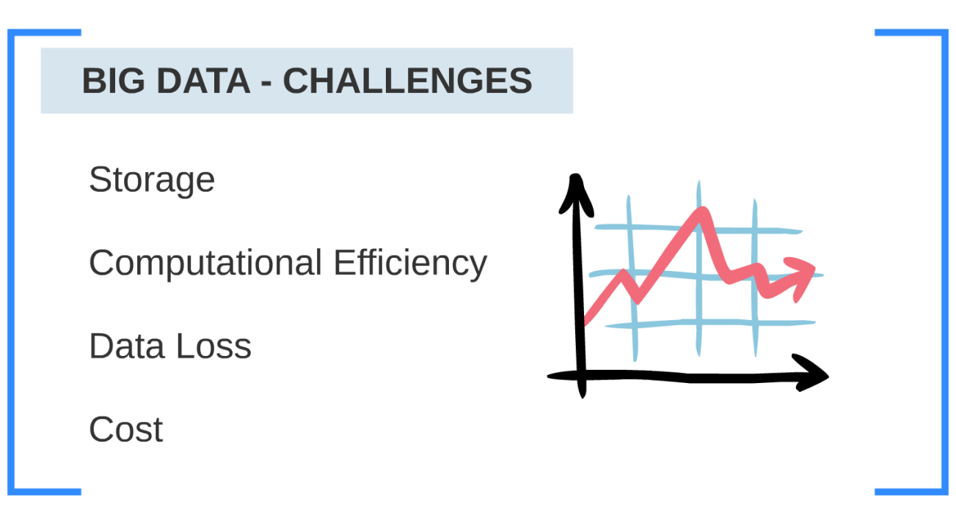

Slide 7
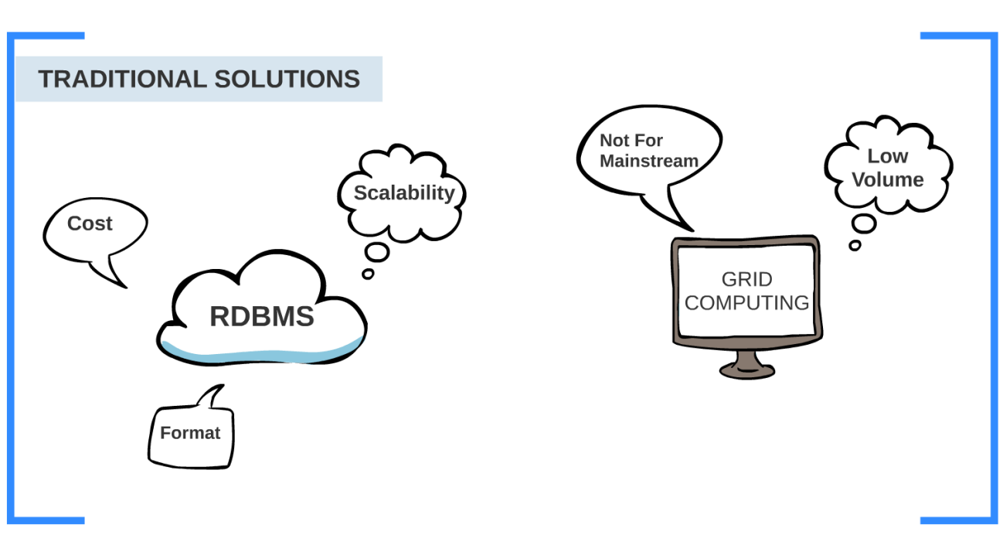

Slide 8
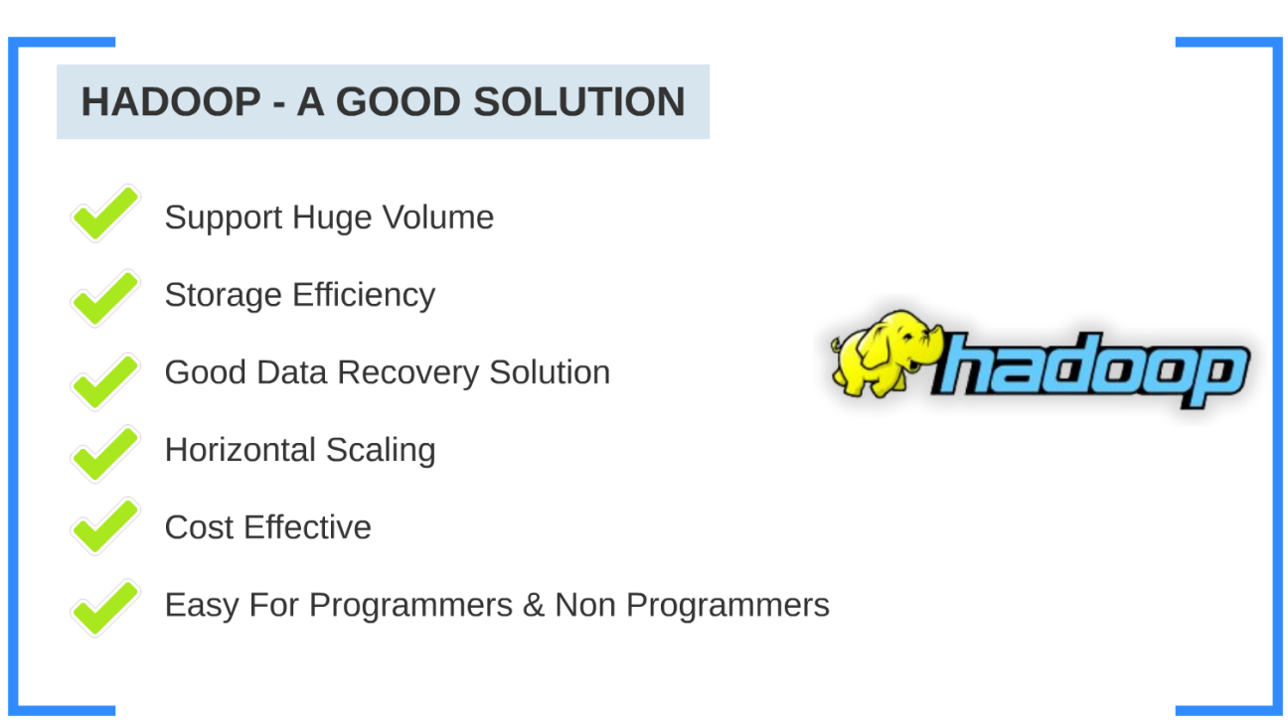

Slide 9
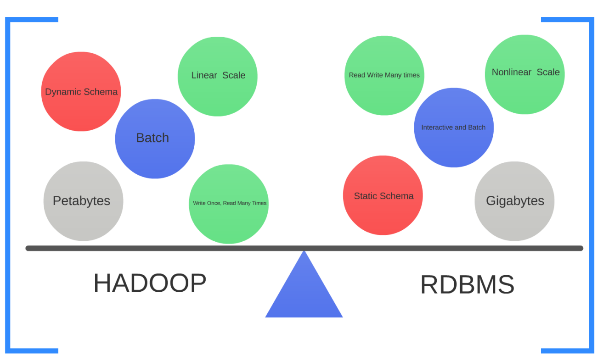

Slide 10
Big Data Application

Slide 11
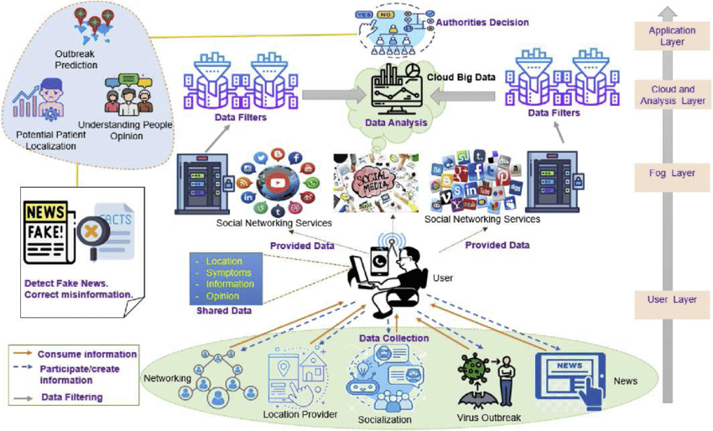

Slide 12
Business Intelligence and Analytics:
Big data is used to analyze historical and real-time data to identify trends, patterns, and correlations, helping organizations make informed decisions, optimize operations, and develop data-driven strategies.
Customer Insights:
Analyzing vast amounts of customer data, including social media interactions, purchase history, and demographic information, helps businesses understand customer behavior and preferences, enabling targeted marketing and improved customer experiences.
Fraud Detection and Security:
Big data analytics can be employed to detect fraudulent activities and enhance cybersecurity by identifying anomalies and patterns indicative of cyber threats.

Slide 13
Healthcare Analytics:
Analyzing electronic health records, medical imaging data, and genomic information can lead to improved patient care, disease prediction, and drug discovery.
Predictive Maintenance:
In industries like manufacturing and aviation, big data is used to predict equipment failures and optimize maintenance schedules, reducing downtime and costs.
Supply Chain Optimization:
Big data helps in tracking products throughout the supply chain, optimizing inventory levels, and improving logistics and distribution efficiency.

Slide 14
Big Data Pipeline

Slide 15
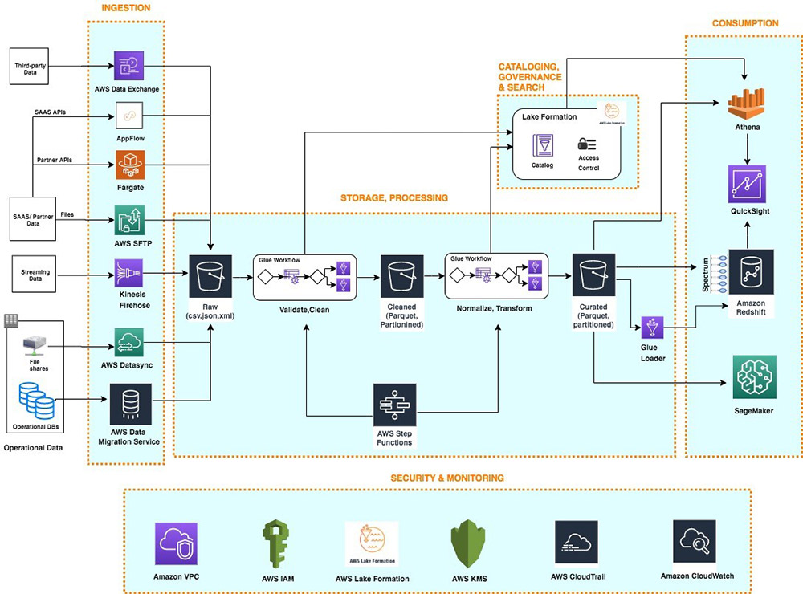
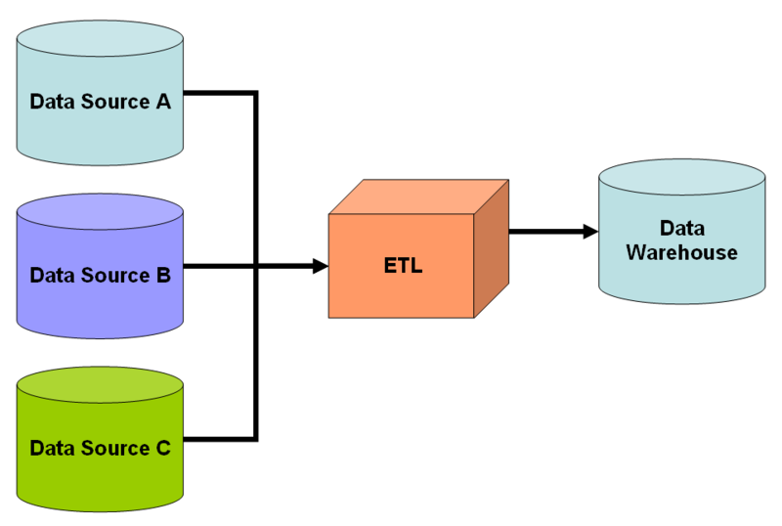
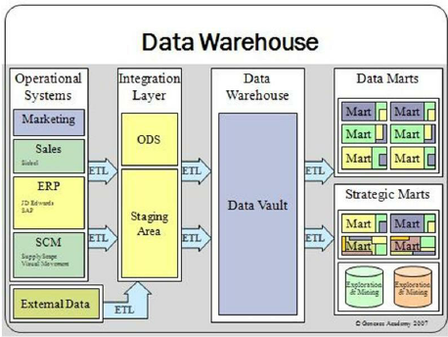
A big data pipeline is a series of processes and tools designed to collect, process, and manage large volumes of data from various sources, transform it into a usable format, and load it into a data storage or analytics system.
The goal of a big data pipeline is to enable organizations to efficiently and effectively work with massive datasets for analysis, reporting, and decision-making.

Slide 16
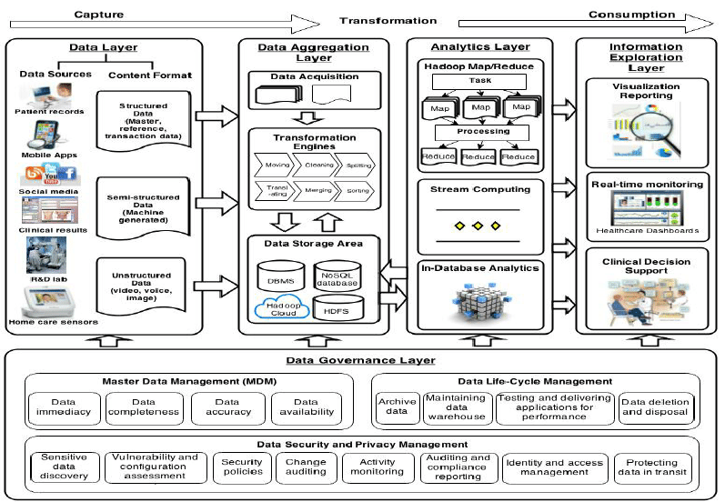

Slide 17
Hadoop Introduction

Slide 18
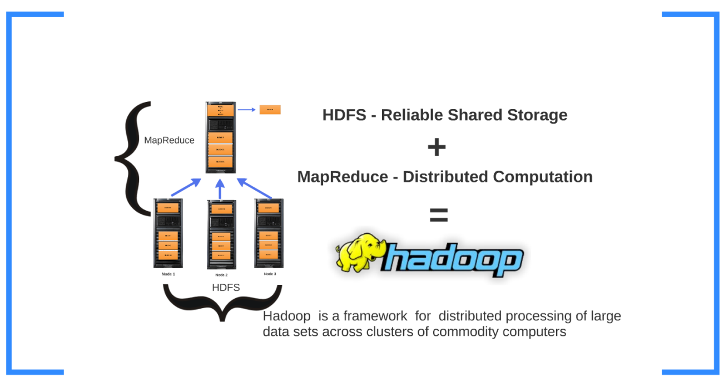

Slide 19
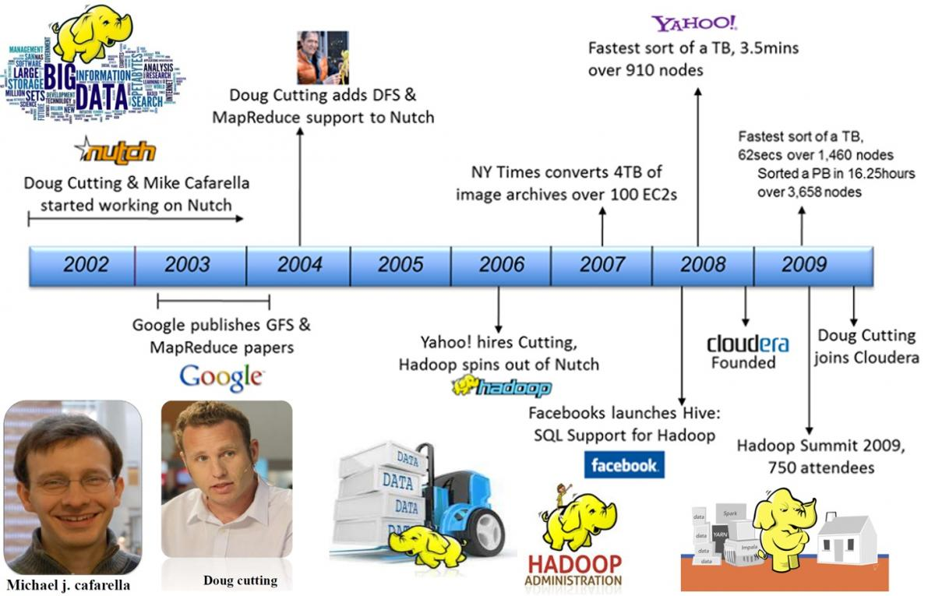

Slide 20
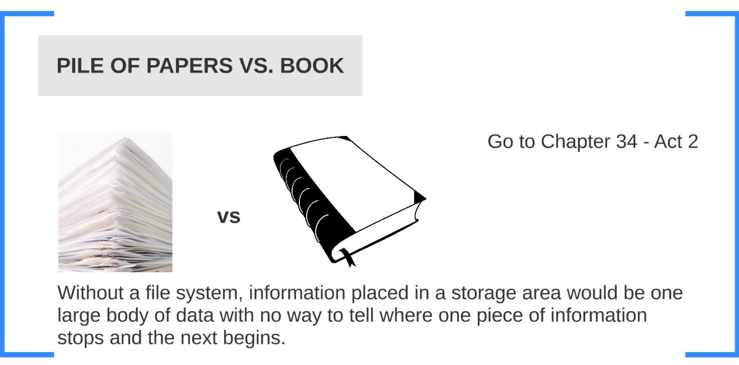

Slide 21
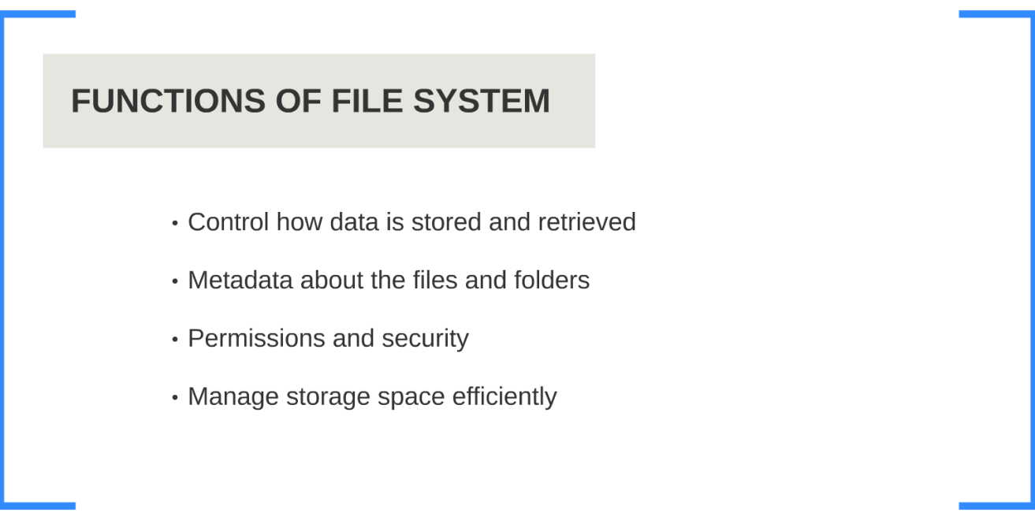

Slide 22
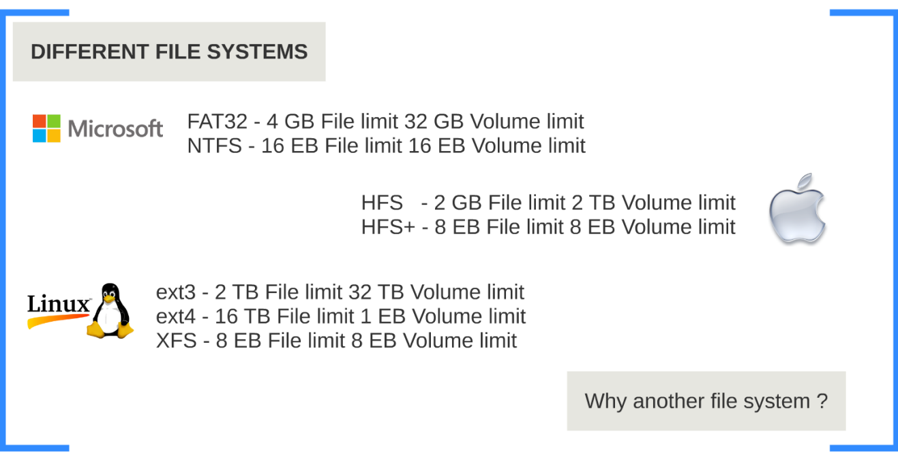

Slide 23
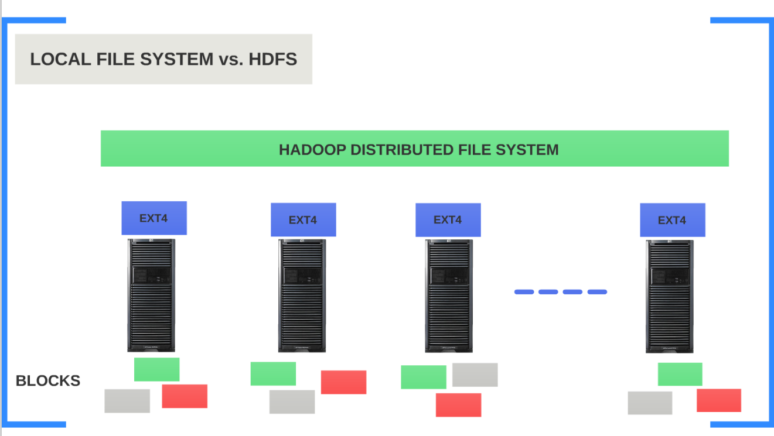

Slide 24
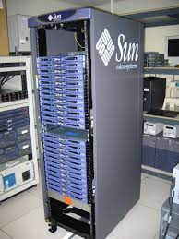
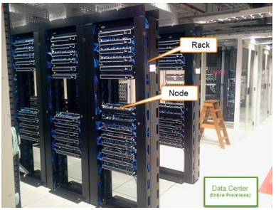
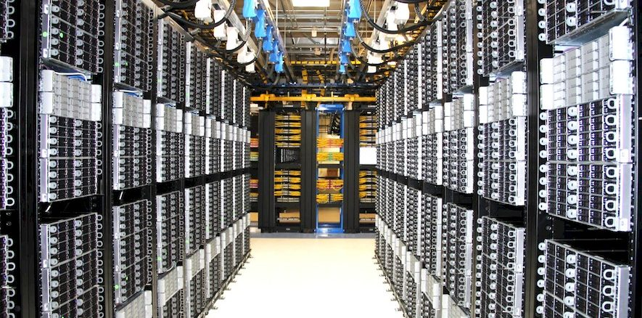

Slide 25
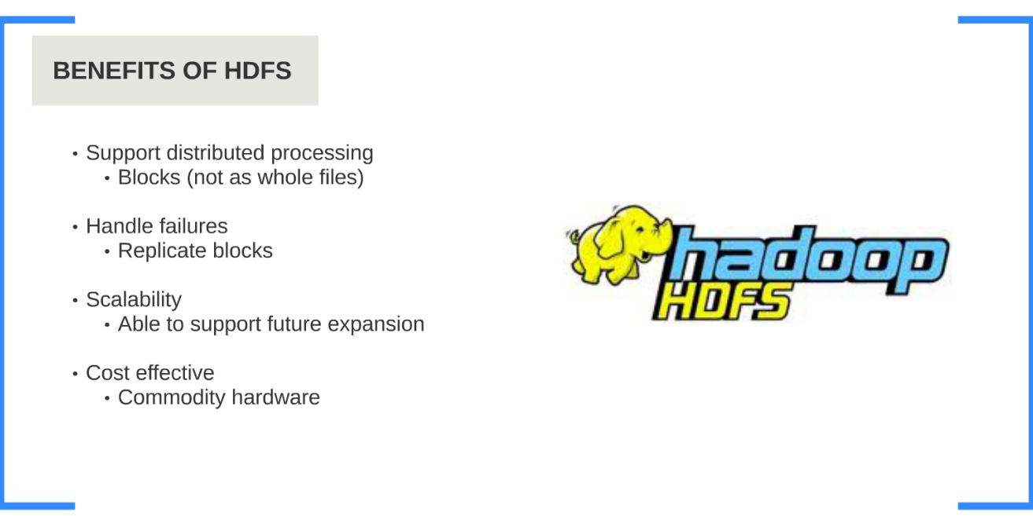

Slide 26
Hadoop Architecture

Slide 27
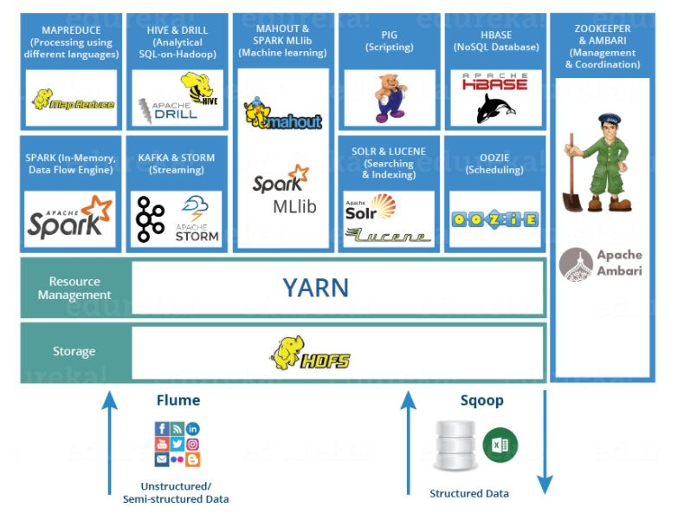

Slide 28
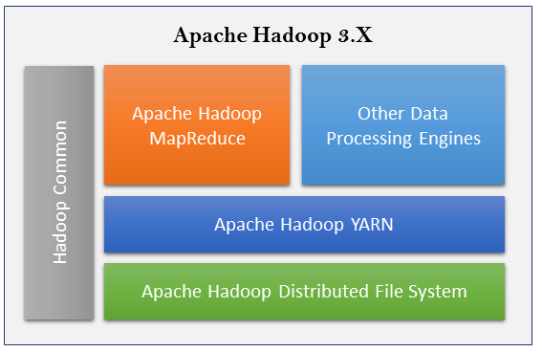

Slide 29
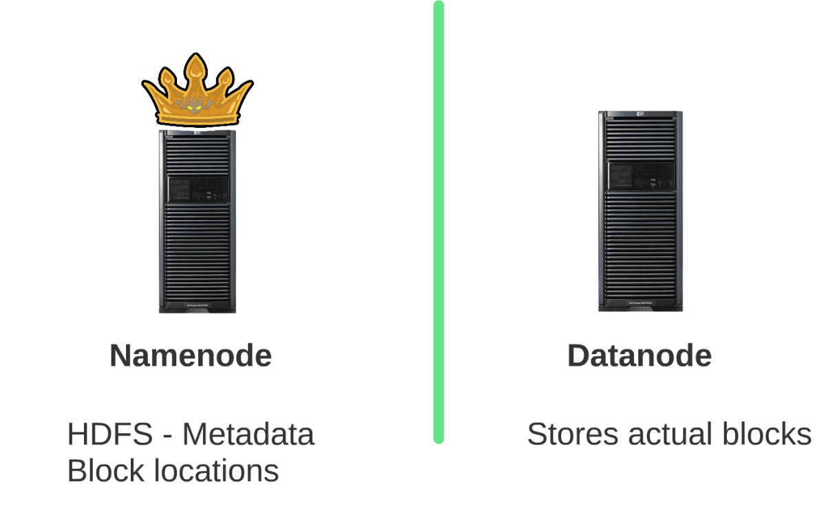


Slide 30
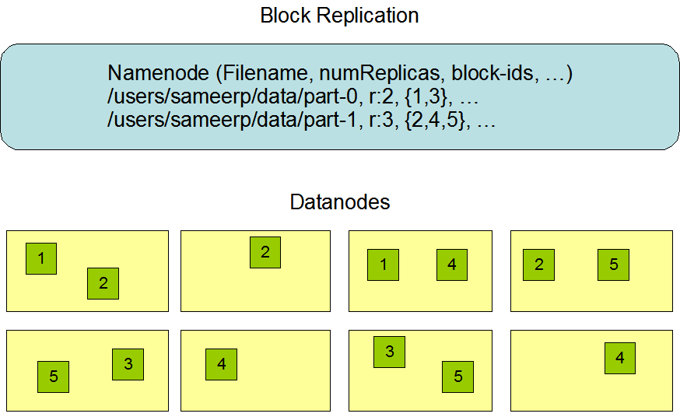
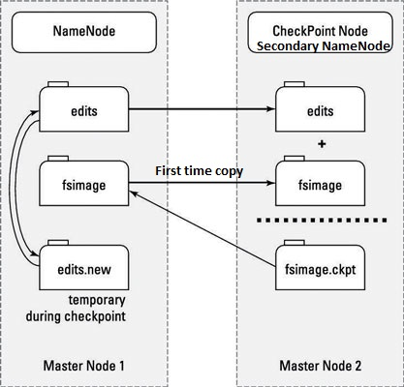

Slide 31
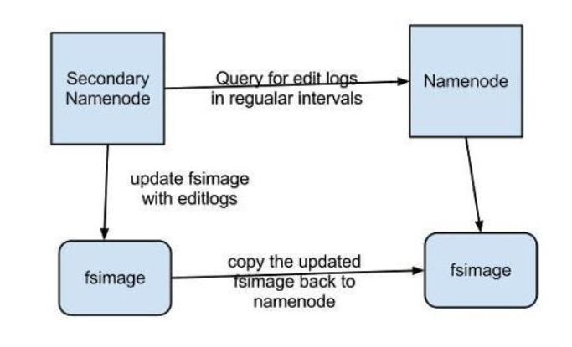

Slide 32
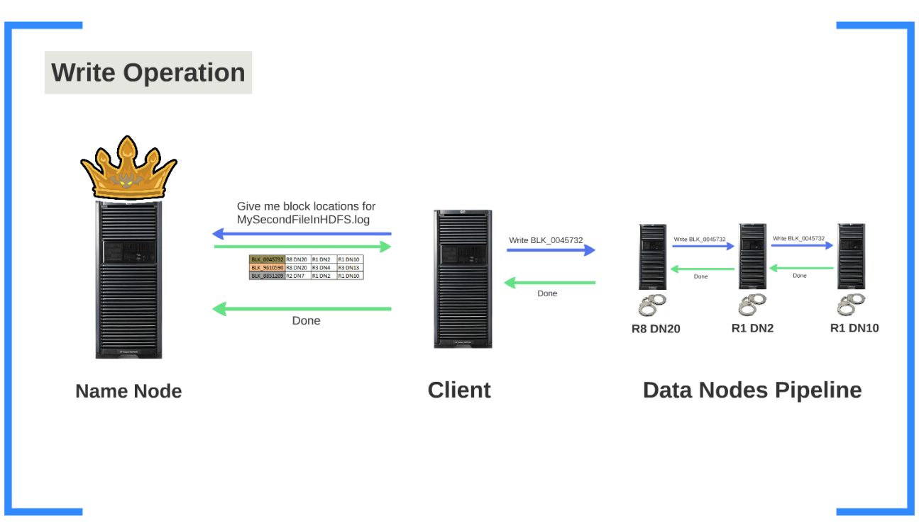

Slide 33
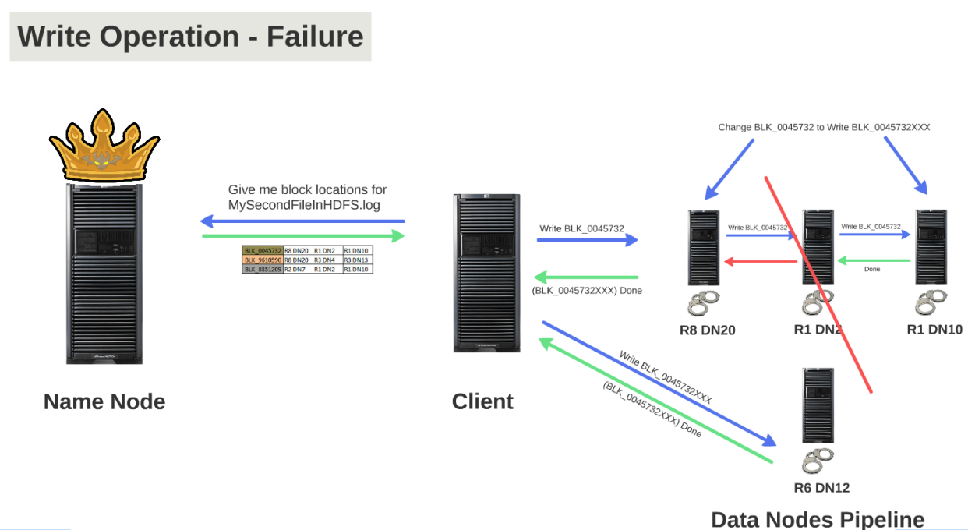

Slide 34
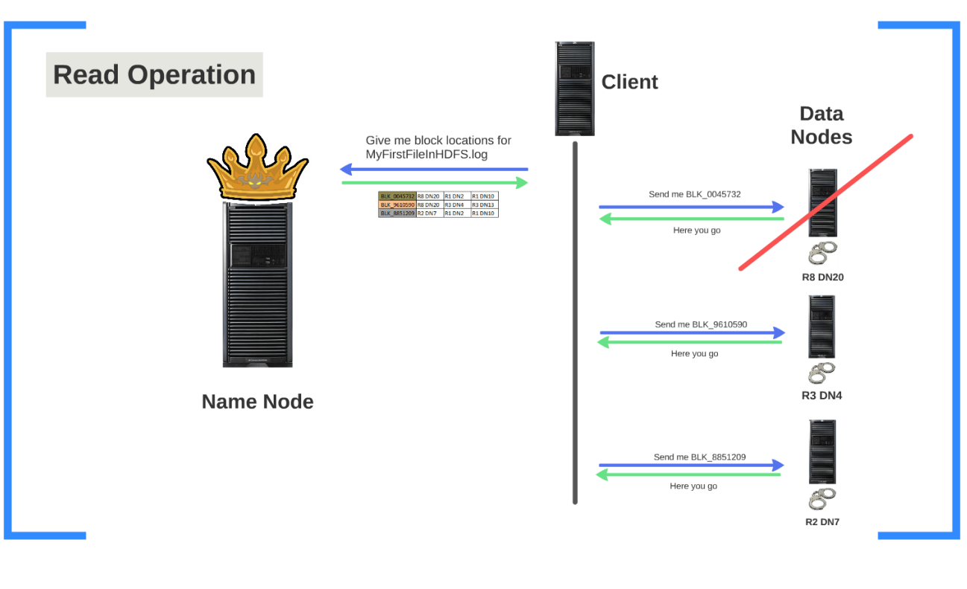

Slide 35
Hadoop Setup And Installation

Slide 36
Hadoop Commands

Slide 37
THANK YOU

